Slide 1
Chapter 16 - Displaying Data
authored by Stephanie Fleischer © SAGE publications Ltd 2014

Slide 2
Topics covered
Methods of communicating and displaying analysed data
Text
Presenting data in tables
Types of graphs
Statistical measures
authored by Stephanie Fleischer © SAGE publications Ltd 2014

Slide 3
Methods of communicating and displaying data
Presenting findings to the reader in a clear way using:
Text
Tables
Graphs
Statistical measures
Analytical style with factual information for quantitative results
Descriptive and narrative writing style for qualitative findings
authored by Stephanie Fleischer © SAGE publications Ltd 2014

Slide 4
Text
“The language of well-written documents helps to communicate information effectively. Language is also the means by which writers create the tone or register of a publication and establish relationships with their readers. For these relationships to be productive, the language the writer uses must take full account of the diversity of knowledge, interests and sensitivities within the audience.”
Commonwealth of Australia Style Manual (2002: 49)
authored by Stephanie Fleischer © SAGE publications Ltd 2014

Slide 5
Presenting data in tables
Most common method to accurately and effectively present analysed data
Frequency tables (univariate, one variable)
Cross tabulations (bivariate, two variables)
Multivariate containing information about more than two variables
Use of percentages to interpret the data presented
authored by Stephanie Fleischer © SAGE publications Ltd 2014

Slide 6
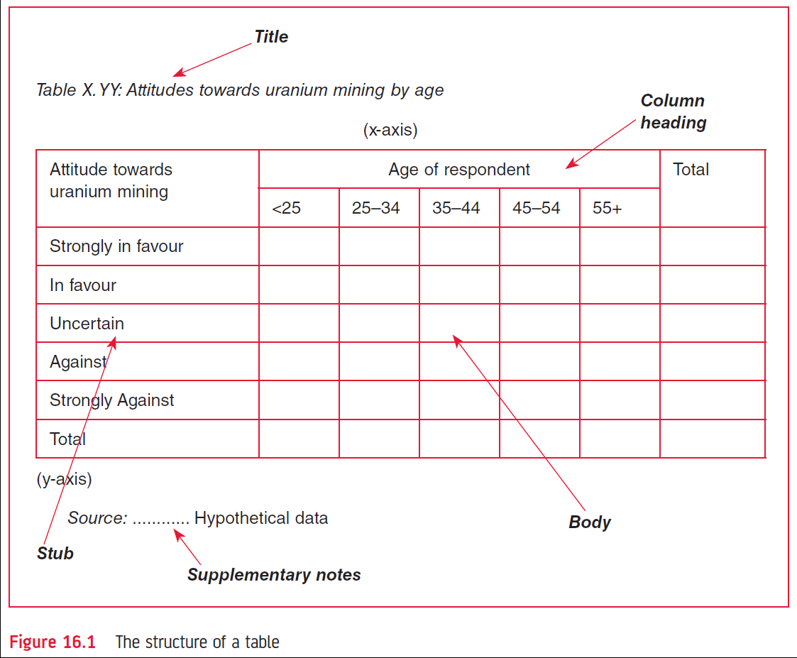
16.1 structure of a table
authored by Stephanie Fleischer © SAGE publications Ltd 2014

Slide 7
Types of percentages
Row percentage
Column percentage
Total percentage
Insert Fig 16.3 Respondents by attitude toward uranium mining and age (cross tabulation – hypothetical data)
authored by Stephanie Fleischer © SAGE publications Ltd 2014

Slide 8
Types of graphs
Histogram
Bar chart
100 per cent bar chart
Frequency polygon
Cumulative frequency polygon
Stem-and leaf display
Pie charts
Line diagram or trend curve
Area chart
Scattergram
authored by Stephanie Fleischer © SAGE publications Ltd 2014

Slide 9
Different charts
Insert Fig 16.4 The stacked bar chart (top left hand side)
Insert Fig 16.5 The 100 per cent bar chart (bottom left hand side)
Insert Fig 16.7 the cumulative frequency polygon (top right hand side)
Insert 16.9 Two- and three-dimensional pie charts (bottom right hand side)
authored by Stephanie Fleischer © SAGE publications Ltd 2014

Slide 10
More charts
Insert Fig 16.10 The line diagram or trend curve (top left hand side)
Insert Fig 16.11 The area chart (bottom left hand side)
Insert Fig 16.12 The scattergram (on right hand side)
authored by Stephanie Fleischer © SAGE publications Ltd 2014

Slide 11
Statistical measures
Dependent on:
Type of data
Knowledge of statistics
Purpose of communicating the results
Descriptives statistics such as mean, mode, median
Inferential statistics like ANOVA, factor analysis or multiple regression
authored by Stephanie Fleischer © SAGE publications Ltd 2014

